Slide 1
RL algorithms analysis
Yue Wang
2017.3.8

Slide 2
Content
Basic notation
Evaluation problem
Objective function
Optimization techniques
Extend to off-policy and eligibility trace
Paper
Control problem
relationship and difference between control and evaluation problem
paper

Slide 3
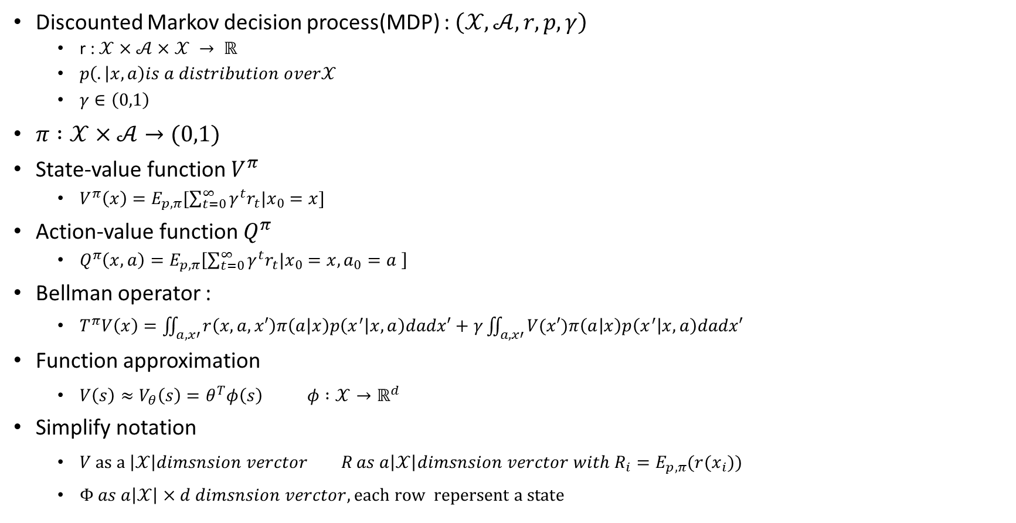
Basic notation
Discounted Markov decision process(MDP) : $\left(𝒳,𝒜,r,p,γ\right)$
r : $𝒳×𝒜×𝒳 → ℝ$
$p\left(. | x,a\right)is a distribution over𝒳$
$γ∈\left(0,1\right)$
$π :𝒳×𝒜→(0,1)$
State-value function $V^{π}$
$V^{π}\left(x\right)=E_{p,π}[\sum_{t=0}^{∞}{γ^{t}r_{t}|x_{0}=x}]$
Action-value function $Q^{π}$
$Q^{π}\left(x,a\right)=E_{p,π}\left[\sum_{t=0}^{∞}{γ^{t}r_{t}|x_{0}=x,a_{0}=a }\right]$
Bellman operator :
$T^{π}V\left(x\right)=\iint_{a,x′}{r\left(x,a,x′\right)π\left(a | x\right)p\left(x^{′} | x,a\right)dadx′}+γ\iint_{a,x′}{V(x′)π\left(a | x\right)p\left(x^{′} | x,a\right)dadx′}$
Function approximation
$V\left(s\right)≈V_{θ}\left(s\right)=θ^{T}φ\left(s\right) φ :𝒳→ℝ^{d}$
Simplify notation
$V as a \left|𝒳\right|dimsnsion verctor R as a\left|𝒳\right|dimsnsion verctor with R_{i}=E_{p,π}(r(x_{i}))$
$Φ as a\left|𝒳\right|×d dimsnsion verctor, each row repersent a state$

Slide 4

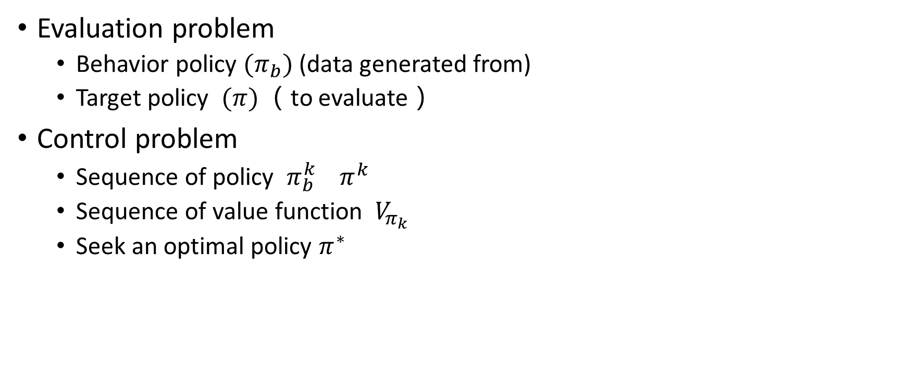
Two class of problems
Evaluation problem
Behavior policy $(π_{b})$ (data generated from)
Target policy $(π)$ （to evaluate）
Control problem
Sequence of policy $π_{b}^{k} π^{k}$
Sequence of value function $V_{π_{k}}$
Seek an optimal policy $π^{∗}$
On policy : $π_{b}=π$
Off policy : $π_{b}≠π$

Slide 5
Evaluation problem
Algorithms for evaluation :
Objection function + optimization techniques

Slide 6

Objective function
$δ=r_{t}+{\left(γϕ_{t+1 }−ϕ_{t}\right)}^{T}θ$
$ϕ_{t}=ϕ(s_{t})$ $D=diag[d^{π}\left(s_{1}\right),…]$
$MSE\left(θ\right)={\left\|V_{θ}−V^{π}\right\|}_{D}^{2}=\sum_{i=1}^{m}{d^{π}\left(s_{i}\right){\left[V_{θ}\left(s_{i}\right)−V^{π}\left(s_{i}\right)\right]}^{2}=E_{d}\left[{\left[V_{θ}\left(s\right)−V^{π}\left(s\right)\right]}^{2} | s_{i}=s_{i}\right]}$
Monte-Carlo
$MSBE\left(θ\right)={\left\|V_{θ}−{TV}_{θ}\right\|}_{D}^{2}=E_{d}\left[E_{p,π}{\left[δ | s_{t}\right]}^{2}\right]=E_{d}\left[{\left({\left(E_{p,π}\left[γφ_{t+1} | s_{t}\right]−φ_{t}\right)}^{T}θ+E_{p,π}\left[r_{t} | s_{t}\right]\right)}^{2}\right]$
Double sampling
$MSTDE\left(θ\right)=E_{d}\left[E_{p,π}\left[δ^{2} | s_{t}\right]\right]=E_{d,p,π}\left[δ^{2}\right]$
Residual TD learning
$MSPBE\left(θ\right)={\left\|V_{θ}−{ΠTV}_{θ}\right\|}_{D}^{2}={\left\|V_{θ}−{TV}_{θ}\right\|}_{DΦ{\left(Φ^{T}DΦ\right)}^{−1}Φ^{T}D}^{2}=E_{d,π,p}{\left[φ_{t}δ_{t}\right]}^{T}E_{d}\left[φ_{t}φ_{t}^{T}\right]E_{d,π,p}\left[φ_{t}δ_{t}\right]={\left\|Φ^{T}D(V_{θ}−{TV}_{θ})\right\|}_{{\left(Φ^{T}DΦ\right)}^{−1}}^{2}$
LSTD, GTD2, TDC
$NEU\left(θ\right)={\left\|{Φ^{T}D(V}_{θ}−{TV}_{θ})\right\|}_{2}^{2}=E_{d,p,π}{\left[δφ\right]}^{T}E_{d,p,π}\left[δφ\right]$
GTD
OPE-FPE
$$θ={argmin}_{θ^{′}}OPE\left(θ^{′},w\right)={argmin}_{θ^{′}}\left\|V_{θ^{′}}−{TV}_{w}\right\|$$
$$w=argmin_{w^{′}}FPE\left(θ,w′\right)={argmin}_{w′}\left\|V_{θ}−{TV}_{w′}\right\|$$
TD learning

Slide 7
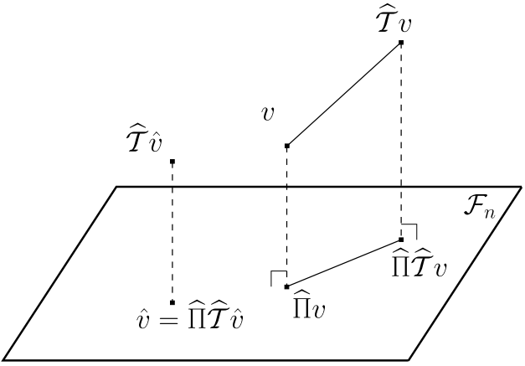
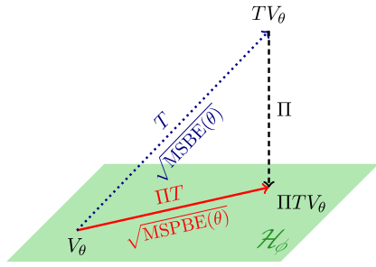
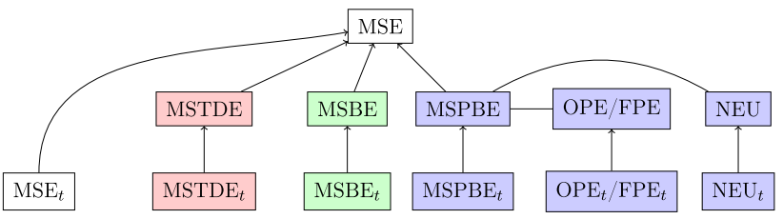
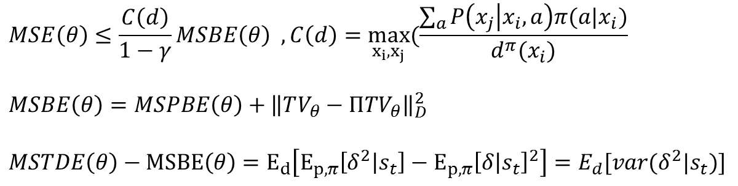
Objective function
$$MSE\left(θ\right)≤\frac{C\left(d\right)}{1−γ}MSBE\left(θ\right) ,C\left(d\right)=\max_{x_{i},x_{j}}(\frac{\sum_{a}{P\left(x_{j} | x_{i},a\right)π(a|x_{i})}}{d^{π}(x_{i})}$$
$$MSBE\left(θ\right)=MSPBE\left(θ\right)+{\left\|TV_{θ}−ΠTV_{θ}\right\|}_{D}^{2}$$
$MSTDE\left(θ\right)−MSBE\left(θ\right)=E_{d}\left[E_{p,π}\left[δ^{2} | s_{t}\right]−E_{p,π}{\left[δ | s_{t}\right]}^{2}\right]=E_{d}[var(δ^{2}|s_{t})]$

Slide 8
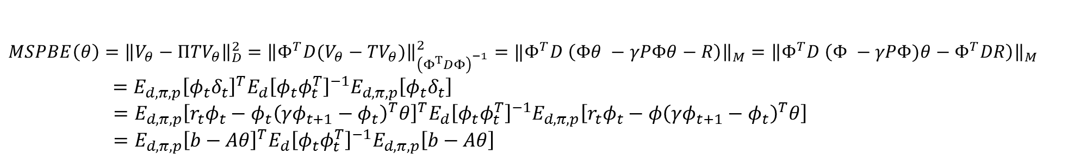
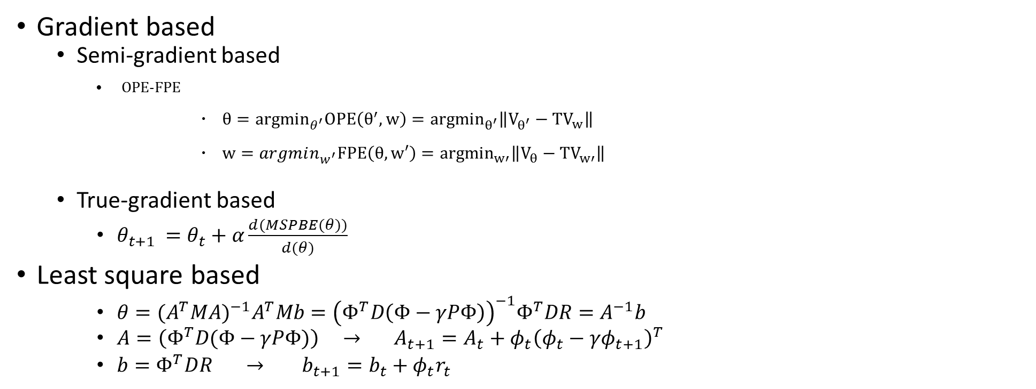
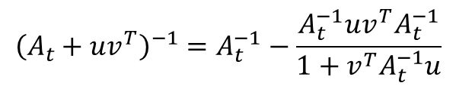
optimization techniques
$MSPBE\left(θ\right)={\left\|V_{θ}−{ΠTV}_{θ}\right\|}_{D}^{2}$ $={\left\|Φ^{T}D(V_{θ}−{TV}_{θ})\right\|}_{{\left(Φ^{T}DΦ\right)}^{−1}}^{2}=‖Φ^{T}D \left(Φθ −γPΦθ−R\right){\left.​\right\|}_{M}={\left\|Φ^{T}D \left(Φ −γPΦ)θ−Φ^{T}DR\right)\right\|}_{M}$
$$=E_{d,π,p}{\left[φ_{t}δ_{t}\right]}^{T}E_{d}{\left[φ_{t}φ_{t}^{T}\right]}^{−1}E_{d,π,p}\left[φ_{t}δ_{t}\right]$$
$=E_{d,π,p}{\left[r_{t}φ_{t}−{φ_{t}\left(γφ_{t+1}−φ_{t}\right)}^{T}θ\right]}^{T}E_{d}{\left[φ_{t}φ_{t}^{T}\right]}^{−1}E_{d,π,p}\left[r_{t}φ_{t}−{φ\left(γφ_{t+1}−φ_{t}\right)}^{T}θ\right]$
$=E_{d,π,p}{\left[b−Aθ\right]}^{T}E_{d}{\left[φ_{t}φ_{t}^{T}\right]}^{−1}E_{d,π,p}\left[b−Aθ\right]$
Gradient based
Semi-gradient based
OPE-FPE
$θ={argmin}_{θ^{′}}OPE\left(θ^{′},w\right)={argmin}_{θ^{′}}\left\|V_{θ^{′}}−{TV}_{w}\right\|$
$w=argmin_{w^{′}}FPE\left(θ,w′\right)={argmin}_{w′}\left\|V_{θ}−{TV}_{w′}\right\|$
True-gradient based
$θ_{t+1 }=θ_{t}+α\frac{d(MSPBE(θ))}{d(θ)}$
Least square based
$θ=({A^{T}MA)}^{−1}A^{T}Mb={\left(Φ^{T}D\left(Φ−γPΦ\right)\right)}^{−1}Φ^{T}DR=A^{−1}b$
$A=\left(Φ^{T}D(Φ−γPΦ)\right) → A_{t+1}=A_{t}+φ_{t}{\left(φ_{t}−γφ_{t+1}\right)}^{T}$
$b=Φ^{T}DR → b_{t+1}=b_{t}+φ_{t}r_{t}$
$${\left(A_{t}+uv^{T}\right)}^{−1}=A_{t}^{−1}−\frac{A_{t}^{−1}uv^{T}A_{t}^{−1}}{1+v^{T}A_{t}^{−1}u}$$

Slide 9


Off policy
On policy : $π_{b}=π$
Off policy : $π_{b}≠π$
$ρ_{k}=\frac{μ(a_{k}|s_{k})}{π(a_{k}|s_{k})}$
Importance sampling(most used)
$\tilde{v}=\frac{\sum_{k=1}^{n}{ρ_{k}v_{k}}}{n}$
Weighted importance sampling
$\hat{v}=\frac{\sum_{k=1}^{n}{ρ_{k}v_{k}}}{\sum_{k=1}^{n}{ρ_{k}}}$
Mahmood, A. Rupam, Hado P. van Hasselt, and Richard S. Sutton. "Weighted importance sampling for off-policy learning with linear function approximation." Advances in Neural Information Processing Systems. 2014.
Mahmood, Ashique Rupam, and Richard S. Sutton. "Off-policy learning based on weighted importance sampling with linear computational complexity." UAI. 2015.

Slide 10
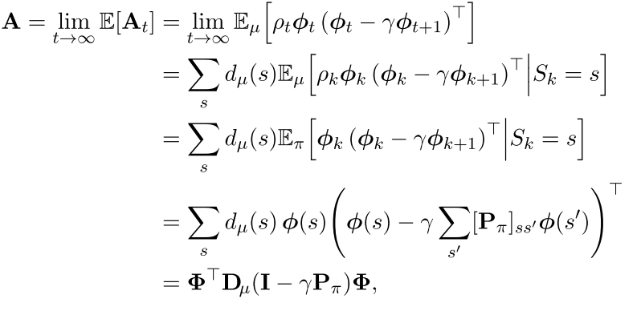


Off-policy TD learning
OPE-FPE
$θ_{t+1 }=θ_{t}+α_{t}ρ_{t}δ_{t}{φ(s}_{t})=θ_{t}+α_{t}(\underset{b_{t}}{\underbrace{ρ_{t}R_{t}φ_{t}}}− \underset{A_{t}}{\underbrace{ρ_{t}φ_{t}{\left(φ_{t}−γφ_{t+1}\right)}^{T}}}θ_{t})$
$ρ_{t}=\frac{π_{G\left(a_{t} | s_{t}\right)}}{π_{B\left(a_{t} | s_{t}\right)}}$
·
Stochastic algorithm is stable
Corresponding deterministic algorithms converge
A matrix has a full set of eigenvalues and real parts are positive
stochastic algorithm is stable + learning rate$α$is reduce according to an appropriate schedule
Convergence almost sure
Schoknecht, Ralf. "Optimality of reinforcement learning algorithms with linear function approximation." NIPS. Vol. 15. 2002.

Slide 11

Off-policy LSTD
On-policy :
$θ=({A^{T}MA)}^{−1}A^{T}Mb={\left(Φ^{T}D\left(Φ−γPΦ\right)\right)}^{−1}Φ^{T}DR=A^{−1}b$
$A=\left(Φ^{T}D(Φ−γPΦ)\right) → A_{t+1}=A_{t}+φ_{t}{\left(φ_{t}−γφ_{t+1}\right)}^{T}$
$b=Φ^{T}DR →b_{t+1}=b_{t}+φ_{t}r_{t}$
Off-policy :
$A_{t+1}=A_{t}+φ_{t}{\left(φ_{t}−γρ_{t}φ_{t+1}\right)}^{T}$
$b_{t+1}=b_{t}+φ_{t}ρ_{t}r_{t}$

Slide 12
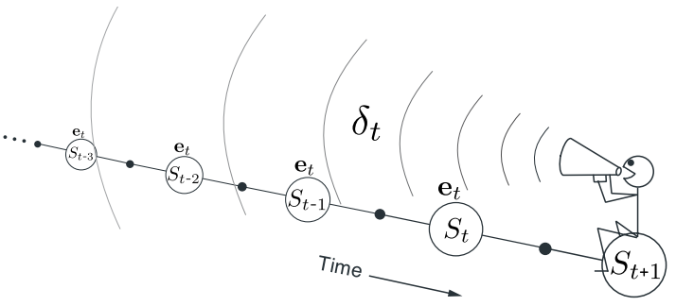
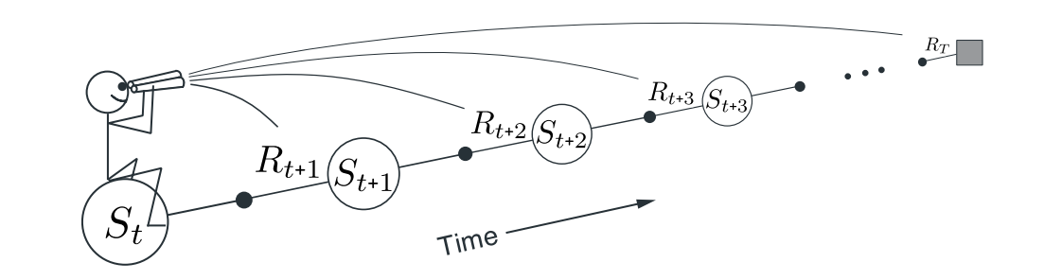
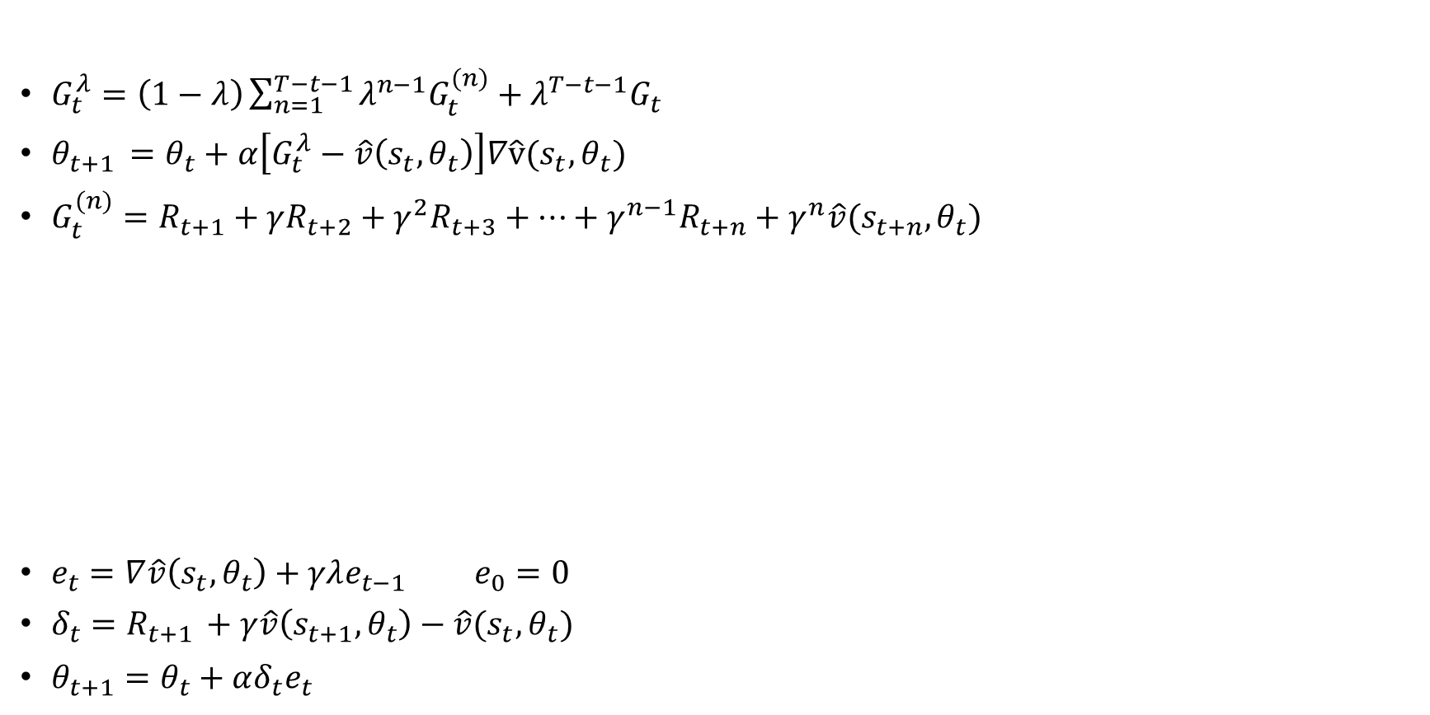
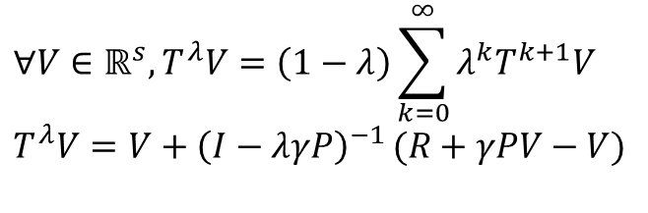
eligibility traces
$$∀V∈ℝ^{s}, T^{λ}V=\left(1−λ\right)\sum_{k=0}^{∞}{λ^{k}T^{k+1}V}$$
$$T^{λ}V=V+{\left(I−λγP\right)}^{−1 }(R+γPV−V)$$
$G_{t}^{λ}=\left(1−λ\right)\sum_{n=1}^{T−t−1}{λ^{n−1}G_{t}^{(n)}}+λ^{T−t−1}G_{t}$
$θ_{t+1 }=θ_{t}+α\left[G_{t}^{λ}−\hat{v}\left(s_{t},θ_{t}\right)\right]∇\hat{v}(s_{t},θ_{t})$
$G_{t}^{(n)}=R_{t+1}+γR_{t+2}+γ^{2}R_{t+3}+…+γ^{n−1}R_{t+n}+γ^{n}\hat{v}(s_{t+n},θ_{t})$
$e_{t}=∇\hat{v}\left(s_{t},θ_{t}\right)+γλe_{t−1} e_{0}=0$
$δ_{t}=R_{t+1 }+γ\hat{v}\left(s_{t+1},θ_{t}\right)−\hat{v}(s_{t},θ_{t})$
$θ_{t+1}=θ_{t}+αδ_{t}e_{t}$

Slide 13
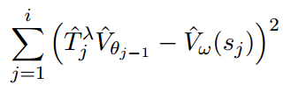
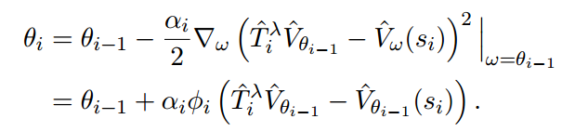

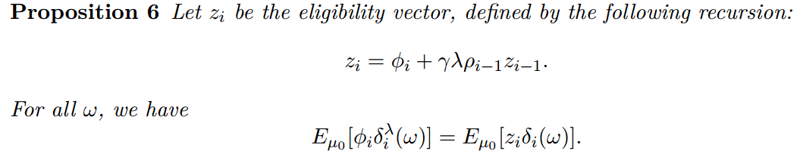

Off policy with eligibility traces(TD($λ$))

Slide 14
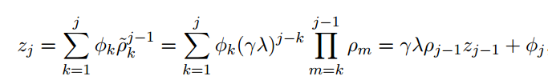
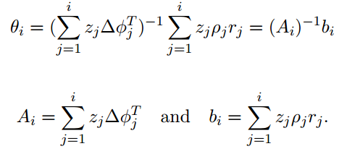

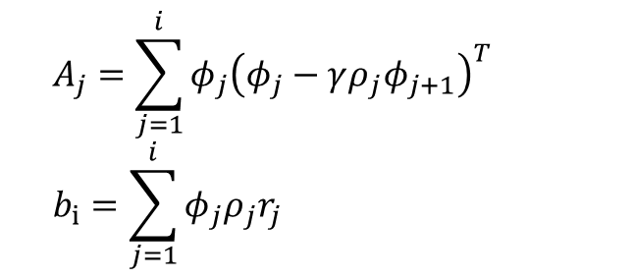

Off policy with eligibility traces(LSTD($λ$))
Without eligibility trace
With eligibility trace
$$A_{j}=\sum_{j=1}^{i}{φ_{j}{\left(φ_{j}−γρ_{j}φ_{j+1}\right)}^{T}}$$
$$b_{i}=\sum_{j=1}^{i}{φ_{j}ρ_{j}r_{j}}$$

Slide 15
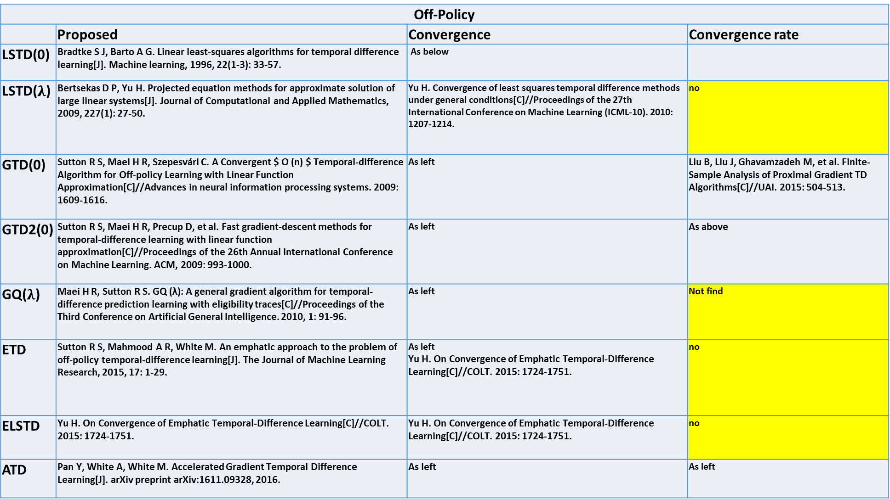
Off-Policy
 | Proposed | Convergence | Convergence rate
LSTD(0) | Bradtke S J, Barto A G. Linear least-squares algorithms for temporal difference learning[J]. Machine learning, 1996, 22(1-3): 33-57. | As below
LSTD($λ$) | Bertsekas D P, Yu H. Projected equation methods for approximate solution of large linear systems[J]. Journal of Computational and Applied Mathematics, 2009, 227(1): 27-50. | Yu H. Convergence of least squares temporal difference methods under general conditions[C]//Proceedings of the 27th International Conference on Machine Learning (ICML-10). 2010: 1207-1214. | no
GTD(0) | Sutton R S, Maei H R, Szepesvári C. A Convergent $ O (n) $ Temporal-difference Algorithm for Off-policy Learning with Linear Function Approximation[C]//Advances in neural information processing systems. 2009: 1609-1616. | As left | Liu B, Liu J, Ghavamzadeh M, et al. Finite-Sample Analysis of Proximal Gradient TD Algorithms[C]//UAI. 2015: 504-513.
GTD2(0) | Sutton R S, Maei H R, Precup D, et al. Fast gradient-descent methods for temporal-difference learning with linear function approximation[C]//Proceedings of the 26th Annual International Conference on Machine Learning. ACM, 2009: 993-1000. | As left | As above
GQ($λ$) | Maei H R, Sutton R S. GQ (λ): A general gradient algorithm for temporal-difference prediction learning with eligibility traces[C]//Proceedings of the Third Conference on Artificial General Intelligence. 2010, 1: 91-96. | As left | Not find
ETD | Sutton R S, Mahmood A R, White M. An emphatic approach to the problem of off-policy temporal-difference learning[J]. The Journal of Machine Learning Research, 2015, 17: 1-29. | As left Yu H. On Convergence of Emphatic Temporal-Difference Learning[C]//COLT. 2015: 1724-1751. | no
ELSTD | Yu H. On Convergence of Emphatic Temporal-Difference Learning[C]//COLT. 2015: 1724-1751. | Yu H. On Convergence of Emphatic Temporal-Difference Learning[C]//COLT. 2015: 1724-1751. | no
ATD | Pan Y, White A, White M. Accelerated Gradient Temporal Difference Learning[J]. arXiv preprint arXiv:1611.09328, 2016. | As left | As left

Slide 16

On-Policy
 | Propose | Convergence | Convergence rate
TD(0) | Sutton R S. Learning to predict by the methods of temporal differences[J]. Machine learning, 1988, 3(1): 9-44. | As left | As below
TD($λ$) | As above | Tsitsiklis J N, Van Roy B. An analysis of temporal-difference learning with function approximation[J]. IEEE transactions on automatic control, 1997, 42(5): 674-690. | Actor-Critic Algorithms?
LSTD(0) | Bradtke S J, Barto A G. Linear least-squares algorithms for temporal difference learning[J]. Machine learning, 1996, 22(1-3): 33-57. | As below | Lazaric A, Ghavamzadeh M, Munos R. Finite-sample analysis of LSTD[C]//ICML-27th International Conference on Machine Learning. 2010: 615-622. Lazaric A, Ghavamzadeh M, Munos R. Finite-sample analysis of least-squares policy iteration[J]. Journal of Machine Learning Research, 2012, 13(Oct): 3041-3074.
LSTD($λ$) | Boyan J A. Technical update: Least-squares temporal difference learning[J]. Machine Learning, 2002, 49(2-3): 233-246. Boyan J A. Least-squares temporal difference learning[C]//ICML. 1999: 49-56. | Nedić A, Bertsekas D P. Least squares policy evaluation algorithms with linear function approximation[J]. Discrete Event Dynamic Systems, 2003, 13(1): 79-110. | Tagorti M, Scherrer B. On the Rate of Convergence and Error Bounds for LSTD (λ)[C]//ICML. 2015: 1521-1529.

Slide 17
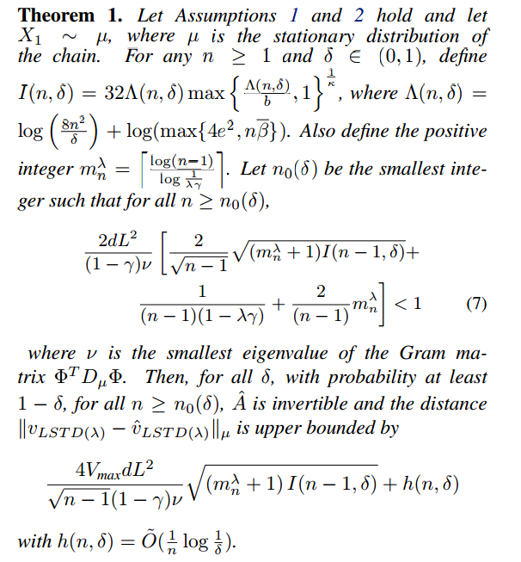

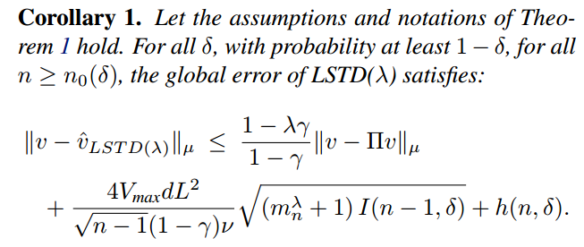


On the rate of convergence and error bounds for LSTD($λ$) 2015 ICML
On-policy, policy evolution, LSTD($λ$)
Theorem :

Slide 18

On the rate of convergence and error bounds for LSTD($λ$) 2015 ICML
On-policy, policy evolution, LSTD($λ$)
Future work:
Extend to policy iteration scheme
LSTD($λ$) for off-policy

Slide 19
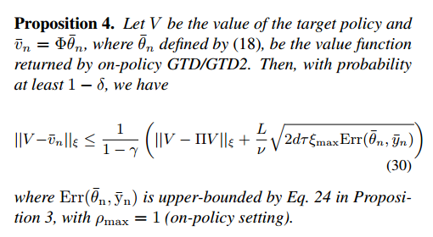
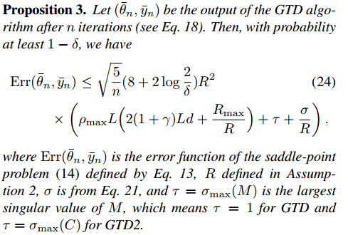
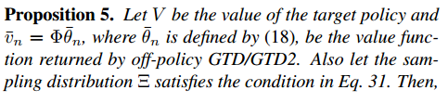
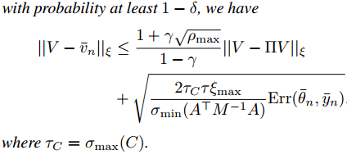
Finite-Sample Analysis of Proximal Gradient TD Algorithms 2015 UAL
On/Off-policy, policy evolution, GTD

Slide 20
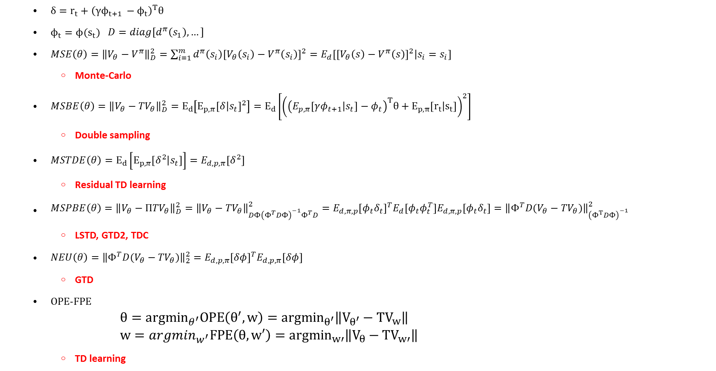
Objective function
$δ=r_{t}+{\left(γϕ_{t+1 }−ϕ_{t}\right)}^{T}θ$
$ϕ_{t}=ϕ(s_{t})$ $D=diag[d^{π}\left(s_{1}\right),…]$
$MSE\left(θ\right)={\left\|V_{θ}−V^{π}\right\|}_{D}^{2}=\sum_{i=1}^{m}{d^{π}\left(s_{i}\right){\left[V_{θ}\left(s_{i}\right)−V^{π}\left(s_{i}\right)\right]}^{2}=E_{d}\left[{\left[V_{θ}\left(s\right)−V^{π}\left(s\right)\right]}^{2} | s_{i}=s_{i}\right]}$
Monte-Carlo
$MSBE\left(θ\right)={\left\|V_{θ}−{TV}_{θ}\right\|}_{D}^{2}=E_{d}\left[E_{p,π}{\left[δ | s_{t}\right]}^{2}\right]=E_{d}\left[{\left({\left(E_{p,π}\left[γφ_{t+1} | s_{t}\right]−φ_{t}\right)}^{T}θ+E_{p,π}\left[r_{t} | s_{t}\right]\right)}^{2}\right]$
Double sampling
$MSTDE\left(θ\right)=E_{d}\left[E_{p,π}\left[δ^{2} | s_{t}\right]\right]=E_{d,p,π}\left[δ^{2}\right]$
Residual TD learning
$MSPBE\left(θ\right)={\left\|V_{θ}−{ΠTV}_{θ}\right\|}_{D}^{2}={\left\|V_{θ}−{TV}_{θ}\right\|}_{DΦ{\left(Φ^{T}DΦ\right)}^{−1}Φ^{T}D}^{2}=E_{d,π,p}{\left[φ_{t}δ_{t}\right]}^{T}E_{d}\left[φ_{t}φ_{t}^{T}\right]E_{d,π,p}\left[φ_{t}δ_{t}\right]={\left\|Φ^{T}D(V_{θ}−{TV}_{θ})\right\|}_{{\left(Φ^{T}DΦ\right)}^{−1}}^{2}$
LSTD, GTD2, TDC
$NEU\left(θ\right)={\left\|{Φ^{T}D(V}_{θ}−{TV}_{θ})\right\|}_{2}^{2}=E_{d,p,π}{\left[δφ\right]}^{T}E_{d,p,π}\left[δφ\right]$
GTD
OPE-FPE
$$θ={argmin}_{θ^{′}}OPE\left(θ^{′},w\right)={argmin}_{θ^{′}}\left\|V_{θ^{′}}−{TV}_{w}\right\|$$
$$w=argmin_{w^{′}}FPE\left(θ,w′\right)={argmin}_{w′}\left\|V_{θ}−{TV}_{w′}\right\|$$
TD learning

Slide 21


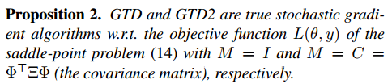
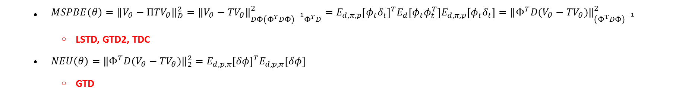
Finite-Sample Analysis of Proximal Gradient TD Algorithms
$MSPBE\left(θ\right)={\left\|V_{θ}−{ΠTV}_{θ}\right\|}_{D}^{2}={\left\|V_{θ}−{TV}_{θ}\right\|}_{DΦ{\left(Φ^{T}DΦ\right)}^{−1}Φ^{T}D}^{2}=E_{d,π,p}{\left[φ_{t}δ_{t}\right]}^{T}E_{d}\left[φ_{t}φ_{t}^{T}\right]E_{d,π,p}\left[φ_{t}δ_{t}\right]={\left\|Φ^{T}D(V_{θ}−{TV}_{θ})\right\|}_{{\left(Φ^{T}DΦ\right)}^{−1}}^{2}$
LSTD, GTD2, TDC
$NEU\left(θ\right)={\left\|{Φ^{T}D(V}_{θ}−{TV}_{θ})\right\|}_{2}^{2}=E_{d,p,π}{\left[δφ\right]}^{T}E_{d,p,π}\left[δφ\right]$
GTD
$J\left(θ\right)={\left\|Φ^{T}D\left(V_{θ}−TV_{θ}\right)\right\|}_{M^{−1}}^{2}={\left\|E[ρ_{t}δ_{t}φ_{t}]\right\|}_{M^{−1}}^{2} M=I for GTD M=Φ^{T}DΦ for GTD2$

Slide 22
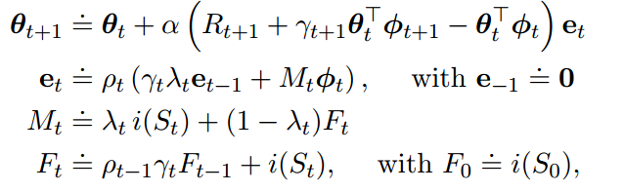
An emphatic approach to the problem of off-policy temporal-difference learning 2016 JMLR
Off-policy, policy evolution,
Future work:
Extend to control setting
Extend to weighted importance sampling
Extend to action-value function

Slide 23
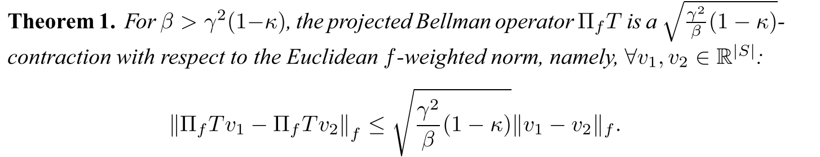
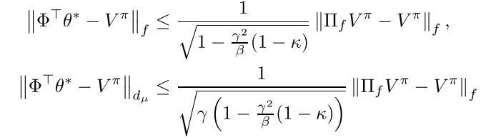

Generalized Emphatic Temporal Difference Learning: Bias-Variance Analysis 2016 AAAI
Off-policy, policy evolution, ETD
ETD$\left(0,β\right)$: $θ_{t+1}=θ_{t}+αF_{t}ρ_{t}\left(r_{t+1}+γθ_{t}^{T}φ_{t+1}−θ_{t}^{T}φ_{t}\right)φ_{t}$
$F_{t}=βρ_{t−1}F_{t−1}+1$
Define : $f=d_{μ}+βP_{π}^{T}d_{μ}+{\left(βP_{π}^{T}\right)}^{2}d_{μ}+…={\left(I−βP_{π}^{T}\right)}^{−1}d_{μ}$ $κ=\min_{s}\frac{d_{μ}(s)}{f(s)} ∈\left[0,1−β\right]$
$⁡$
Bias analysis:

Slide 24
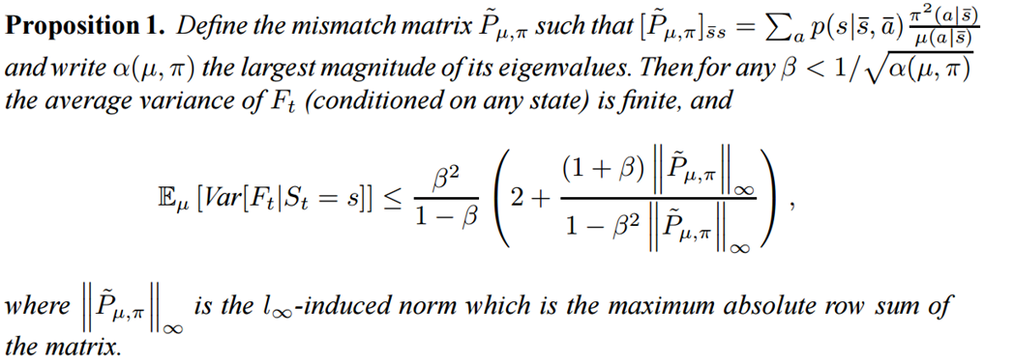

Generalized Emphatic Temporal Difference Learning: Bias-Variance Analysis 2016 AAAI
Off-policy, policy evolution, ETD
ETD$\left(0,β\right)$: $θ_{t+1}=θ_{t}+αF_{t}ρ_{t}\left(r_{t+1}+γθ_{t}^{T}φ_{t+1}−θ_{t}^{T}φ_{t}\right)φ_{t}$
$F_{t}=βρ_{t−1}F_{t−1}+1$
Define : $f=d_{μ}+βP_{π}^{T}d_{μ}+{\left(βP_{π}^{T}\right)}^{2}d_{μ}+…={\left(I−βP_{π}^{T}\right)}^{−1}d_{μ}$ $κ=\min_{s}\frac{d_{μ}(s)}{f(s)} ∈\left[0,1−β\right]$
Variance analysis :

Slide 25
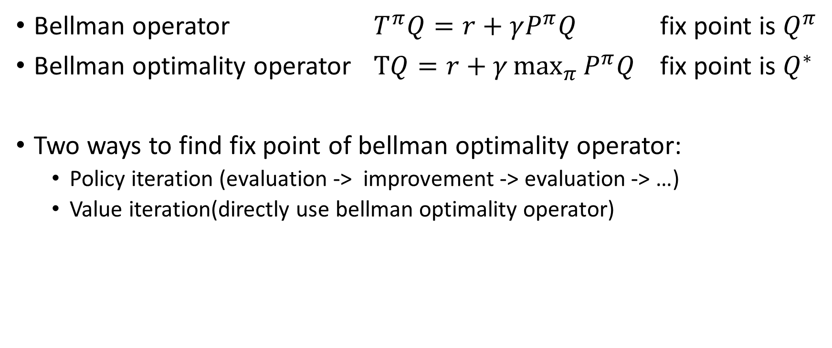
Control problem
Bellman operator $T^{π}Q=r+γP^{π}Q$ fix point is $Q^{π}$
Bellman optimality operator $TQ=r+γ\max_{π}{P^{π}Q}$ fix point is $Q^{∗}$
Two ways to find fix point of bellman optimality operator:
Policy iteration (evaluation -> improvement -> evaluation -> …)
Value iteration(directly use bellman optimality operator)

Slide 26
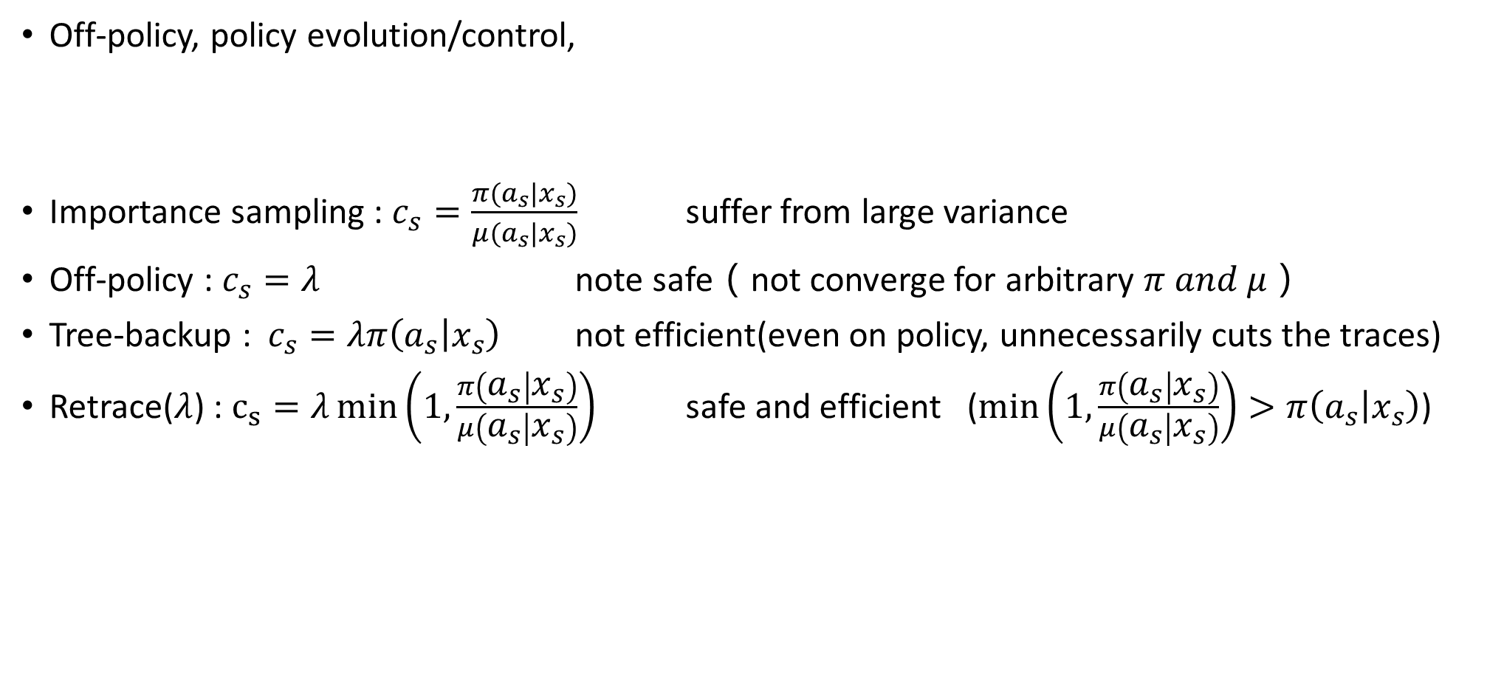
Safe and efficient off-policy reinforcement learning 2016 NIPS
Off-policy, policy evolution/control,
Importance sampling : $c_{s}=\frac{π(a_{s}|x_{s})}{μ(a_{s}|x_{s})}$ suffer from large variance
Off-policy : $c_{s}=λ$ note safe（not converge for arbitrary $π and μ$）
Tree-backup : $c_{s}=λπ\left(a_{s} | x_{s}\right)$ not efficient(even on policy, unnecessarily cuts the traces)
Retrace($λ$) : $c_{s}=λ\min\left(1,\frac{π\left(a_{s} | x_{s}\right)}{μ\left(a_{s} | x_{s}\right)}\right)$ safe and efficient ($\min\left(1,\frac{π\left(a_{s} | x_{s}\right)}{μ\left(a_{s} | x_{s}\right)}\right)>π\left(a_{s} | x_{s}\right)$)

Slide 27
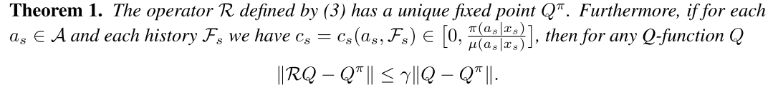
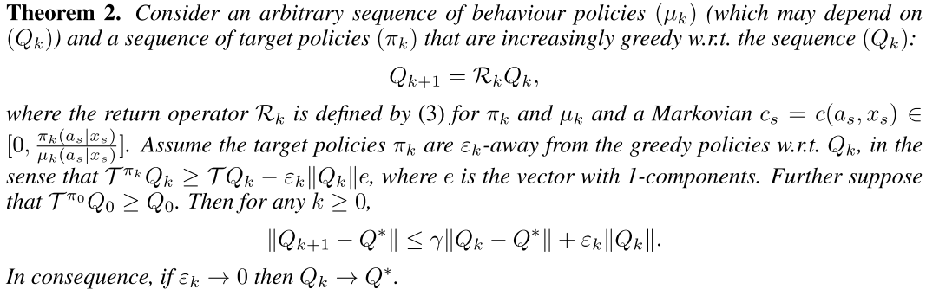
Safe and efficient off-policy reinforcement learning 2016 NIPS

Slide 28
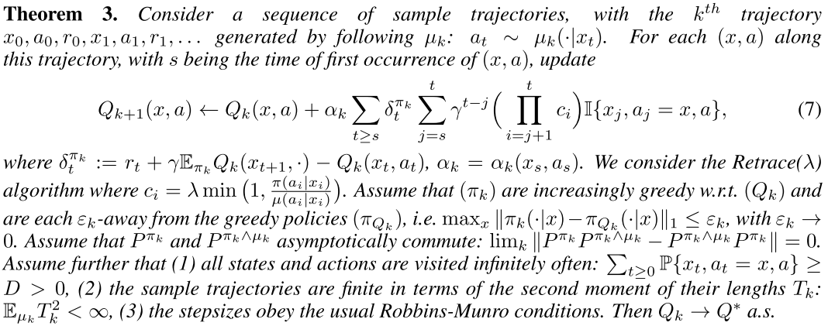
Safe and efficient off-policy reinforcement learning 2016 NIPS

Slide 29





Finite-sample analysis of least-squares policy iteration JMLR2012
the performance is evaluated only at the states visited by the Markov chain and no generalization on other states is possible
Error bound of LSTD on assumption of
Markov chain
Uniqueness of LSTD solution
$$if n>n_{0}\left(δ\right), then with probability 1−δ:$$
$$the family of features is linearly independent and the smallest eigenvalue of Φ^{T}Φ>0$$
$$let X_{1},…X_{n} generated by a stationary β−mixing process, then with probability 1−δ:$$
$$\left\|\hat{V}−V\right\|≤O\left(\frac{1}{\sqrt{1−γ^{2}}}{\left\|V−ΠV\right\|}_{ρ}+\frac{1}{1−γ}\sqrt{\frac{1}{n}}\right)$$
Error bound of LSTD on assumption of
Markov chain with stationary distribution $ρ$
$$let V_{0},…V_{K} be the sequence of value function generated by LSPI after k iterations,$$
$$π_{k} is the greedy policy w.r.t the truncated value function {\hat{V}}_{k−1}, then with probability 1−δ:$$
$$\left\|V^{π_{k}}−V^{∗}\right\|≤O\left(\frac{γ(1+γ)}{{\left(1−γ\right)}^{2}\sqrt{1−γ^{2}}}\sup_{π∈𝒢\left(\tilde{ℱ}\right)}{\inf_{f∈ℱ}{{\left\|f−V^{π}\right\|}_{ρ^{π}}+}}\frac{γ(γ+1)}{{\left(1−γ\right)}^{3}}\sqrt{\frac{k}{n}}+γ^{k/2}\right)$$
Error bound of LSPI on assumption of
Markov chain with stationary distribution $ρ$
Farahmand, Amir-massoud, Csaba Szepesvári, and Rémi Munos. "Error propagation for approximate policy and value iteration." Advances in Neural Information Processing Systems. 2010.

Slide 30
Summary
RL notation and setting
Focus on linear function approximation and value function based algorithms.
Evaluation problem
Objective function
optimization techniques
Extension to off-policy case and eligibility trace
Analysis about algorithms’ convergence, convergence rate, bias and variance
Control problem
Two ways to find fix point of bellman optimality operator
Plan
A papers list about other topic related to RL algorithms analysis in icml and nips from 2014 to 2016
Select some of these papers for next seminar. Concentrate on story.

Slide 31
Thanks

Slide 32

Importance sampling
Off policy learning ($π_{b}≠π_{g}$)
Importance sampling
Weighted IS
Look-up table
Function approximation
No IS
Look-up table
Function approximation

Slide 33

Some useful theorem
Almost sure convergence
$p\left(\lim_{n→∞}{x_{n}=x}\right)=1$
Converge in probability
$\lim_{n→∞}{p\left(\left|x_{n}−x\right|>ε\right)=0}$
Khintchine strong law of large number
${\left\{x_{i}\right\}}_{i=1}^{∞} iid, \frac{1}{n}\sum_{i=1}^{n}{x_{i}}→E\left(x_{1}\right) a.s.$
Kolmogorov strong law of large numbers
${\left\{x_{i}\right\}}_{i=1}^{∞} independent, bound variance and same mean, \frac{1}{n}\sum_{i=1}^{n}{x_{i}}→E\left(x_{1}\right) a.s.$
Weak law of large numbers
${\left\{x_{i}\right\}}_{i=1}^{∞} iid, E\left(\left|x_{i}\right|\right)<∞, \frac{1}{n}\sum_{i=1}^{n}{x_{i}}→E\left(x_{1}\right) in probability$

Slide 34

Importance sampling (for Monte carol method)
$Q_{N}^{IS}\left(s,a\right)=\frac{\sum_{i=1}^{N}{R_{i}w_{i}}}{N}$
Unbiased
$E_{b}\left[\frac{\sum_{i=1}^{N}{R_{i}w_{i}}}{N}\right]=E_{π}[\frac{\sum_{i=1}^{N}{R_{i}}}{N}]=Q^{π}(s,a)$
Consistent

Slide 35

Weighted importance sampling (for Monte carol method)
$Q_{N}^{WIS}\left(s,a\right)=\frac{\sum_{i=1}^{N}{R_{i}w_{i}}}{\sum_{i=1}^{N}{w_{i}}}$
Variance analysis
${var(Q}_{N}^{WIS})→0$
Proof : convergence a.s. imply variance $→ 0$
Biased
Consistent

Slide 36

$MSE\left(θ\right)={\left\|V_{θ}−V^{π}\right\|}_{D}^{2}=\sum_{i=1}^{m}{d^{π}\left(s_{i}\right){\left[V_{θ}\left(s_{i}\right)−V^{π}(s_{i})\right]}^{2}=E_{d}[{\left[V_{θ}\left(s\right)−V^{π}\left(s\right)\right]}^{2}|s_{i}=s_{i}]}$
$MSBE\left(θ\right)={\left\|V_{θ}−{TV}_{θ}\right\|}_{D}^{2}=E_{d}[E_{p,π}{\left[δ | s_{t}\right]}^{2}]$
$MSTDE\left(θ\right)=E_{d}\left[E_{p,π}\left[δ^{2} | s_{t}\right]\right]=E_{d,p,π}[δ^{2}]$
$MSPBE\left(θ\right)={\left\|V_{θ}−{ΠTV}_{θ}\right\|}_{D}^{2}={\left\|V_{θ}−{TV}_{θ}\right\|}_{DΦ{\left(Φ^{T}DΦ\right)}^{−1}Φ^{T}D}^{2}=E_{d,π,p}{\left[φ_{t}δ_{t}\right]}^{T}E_{d}[φ_{t}φ_{t}^{T}]E_{d,π,p}[φ_{t}δ_{t}]$
$NEU\left(θ\right)={\left\|{Φ^{T}D(V}_{θ}−{TV}_{θ})\right\|}_{2}^{2}=E_{d,p,π}{\left[δφ\right]}^{T}E_{d,p,π}[δφ]$
Notes:
$$={\left[V_{θ}−V^{π}\right]}^{T}D\left[V_{θ}−V^{π}\right]$$

Slide 37

On converge of emphatic temporal difference learning

Slide 38

Control problem
Relationship with evaluation problem
Policy iteration algorithms(evaluation -> improvement -> evaluation -> …)
Difference with evaluation problem
A sequence Q function $Q_{k}$ and policy $π_{k}$ other than a fixed policy $π$

Slide 39

 |  | Evaluation | Control
Look-up table |  | TD(0) with importance sampling | Q-learning
 |  | Retrace($λ$) | Retrace($λ$)
 |  | Q($λ$) with off policy correction | Q($λ$) with off policy correction
Linear function approximation | Semi-gradient method | Semi-gradient TD(0) | Semi-gradient Q-learning
 | Gradient method | R-TD | Greedy-GQ
 |  | GTD(GTD2,TDC)
 |  | GQ(\lambda)
 |  | Emphatic TD
 | Least square method | LSTD
 |  | Emphatic LSTD

Slide 40
[1] H. Yu JANEYHZYU, “On Convergence of Emphatic Temporal-Difference Learning *,” 2015.
[1] R. S. Sutton, A. R. Mahmood, and M. White, “An Emphatic Approach to the Problem of Off-policy Temporal-Difference Learning,” J. Mach. Learn. Res., vol. 17, pp. 1–29, 2016.
[1] A. Hallak, A. Tamar, R. Munos, and S. Mannor, “Generalized Emphatic Temporal Difference Learning: Bias-Variance Analysis,” in Proceedings of the 30th Conference on Artificial Intelligence (AAAI 2016), 2016, no. Yu, pp. 1–17.
[1] A. Harutyunyan, M. G. Bellemare, T. Stepleton, and R. Munos, “Q(??) with off-policy corrections,” Lect. Notes Comput. Sci. (including Subser. Lect. Notes Artif. Intell. Lect. Notes Bioinformatics), vol. 9925 LNAI, pp. 305–320, 2016.
[1] R. Munos, T. Stepleton, A. Harutyunyan, and M. Bellemare, “Safe and Efficient Off-Policy Reinforcement Learning,” Nips, pp. 1046–1054, 2016.
[1] B. Liu, J. Liu, M. Ghavamzadeh, S. Mahadevan, and M. Petrik, “Finite-Sample Analysis of Proximal Gradient TD Algorithms,” Uai, 2015.
[1] I. Osband and B. Van Roy, “On Lower Bounds for Regret in Reinforcement Learning,” pp. 1–10, 2016.
[1] M. Tagorti and B. Scherrer, “On the Rate of Convergence and Error Bounds for LSTD (λ).,” ICML, 2015.
[1] A. R. Mahmood, H. van Hasselt, and R. S. Sutton, “Weighted importance sampling for off-policy learning with linear function approximation,” Proc. Adv. Neural Inf. Process. Syst., pp. 1–12, 2014.

Slide 41
Evaluation problem
Look up table setting

Slide 42

$MSPBE\left(θ\right)={\left\|V_{θ}−{ΠTV}_{θ}\right\|}_{D}^{2}={\left\|V_{θ}−{TV}_{θ}\right\|}_{DΦ{\left(Φ^{T}DΦ\right)}^{−1}Φ^{T}D}^{2}$ $={\left\|Φ^{T}D(V_{θ}−{TV}_{θ})\right\|}_{{\left(Φ^{T}DΦ\right)}^{−1}}^{2}$
$$=E_{d,π,p}{\left[φ_{t}δ_{t}\right]}^{T}E_{d}\left[φ_{t}φ_{t}^{T}\right]E_{d,π,p}\left[φ_{t}δ_{t}\right]$$
$=E_{d,π,p}{\left[r_{t}φ_{t}−{φ\left(γφ_{t+1}−φ_{t}\right)}^{T}θ\right]}^{T}E_{d}\left[φ_{t}φ_{t}^{T}\right]E_{d,π,p}\left[r_{t}φ_{t}−{φ\left(γφ_{t+1}−φ_{t}\right)}^{T}θ\right]$
$=E_{d,π,p}{\left[b−Aθ\right]}^{T}E_{d}\left[φ_{t}φ_{t}^{T}\right]E_{d,π,p}\left[b−Aθ\right]$

Slide 43

Importance sampling (for Monte carol method)
$G\left(π\right)=E\left[G\left(H_{L}\right) | H_{L}\sim π\right]∈[0,1]$
Upper and lower bound
Unbiasedness
Consistency

Slide 44

Importance sampling ratio
For distribution
$ρ_{k}=\frac{g(x_{k})}{b(x_{k})}$
For MDP
$ρ_{i}^{j}=\prod_{k=i}^{k=j−1}{\frac{π_{g}\left(a_{k} | s_{k}\right)}{π_{b}\left(a_{k} | s_{k}\right)}}=\prod_{k=i}^{k=j−1}{ρ_{i}}$
$ρ_{k}=ρ_{k}^{k+1}=\frac{π_{g}\left(a_{k} | s_{k}\right)}{π_{b}\left(a_{k} | s_{k}\right)}$

